Slide 1
App Revenue Maximizing Model
Boyoung Kim
Notes:
I have several friends who have ideas for apps and who have the engineering skills to build it.
But what it always comes down to is, I don’t know how we’re going to monetize it. I wanted to see if there are any revenue-generating models for apps that are better than another.

Slide 2
Problem Statement
What Business Model Generates the Highest Revenue Per Download for Free Mobile Applications?
Only Ad Supported
Only In-App Purchases
Both Ad Supported and In-App Purchases

Slide 3
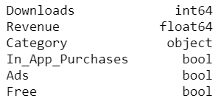
Data Overview
Sensor Tower data of top downloaded apps from Google Play Store and Apple App Store in 2017
Data on 1,466 apps:

Slide 4
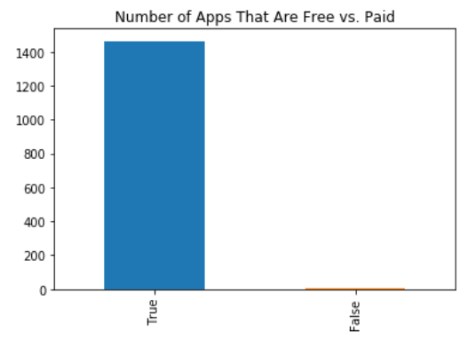
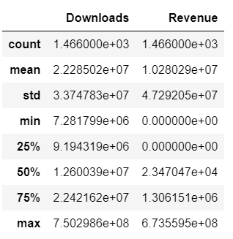
Data Preparation Part 1: Filtering for Free & Revenue-Generating Apps
Removing paid apps and apps with no revenue
Notes:
After filtering for this, I still had roughly 900 apps on which I could run my study.

Slide 5
Data Preparation Part 2: Creating Data Frames by Business Model
Setting Conditions on Values in “In_App_Purchase” and “Ads” Columns by True/False
Top Downloaded Apps in Google Play and Apple App Store in 2017
Free
Revenue > 0
Revenue = 0
Paid
Ad Support Only
In-App Purchase Only
Ad Support & In App Purchase Only

Slide 6
Predict App Revenue Based Only on the Number of Downloads
For Each of the Three Filtered Data Sets:
Ads Only: 69 Apps
In App Purchase Only: 133 Apps
Ads and In-App Purchase: 684 Apps
In Every Data Set, using:
Downloads as the X variable
Revenue as the Y variable

Slide 7
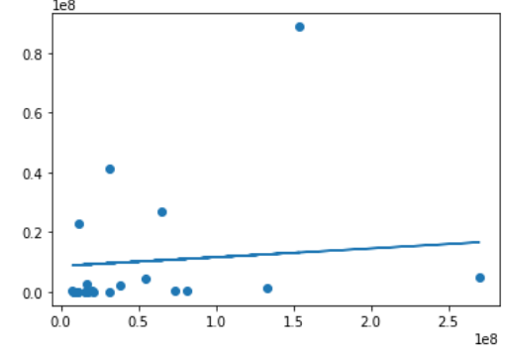
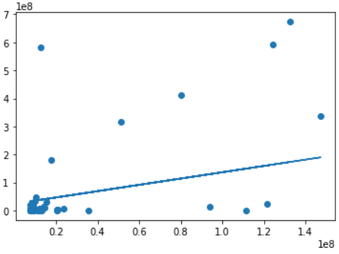
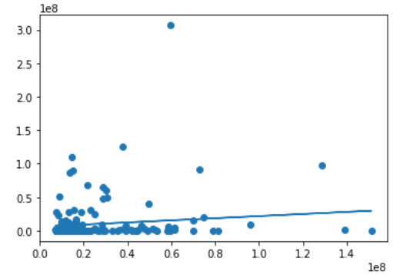
Linear Regression Model Train on 70% of the data and test on the other 30%
Revenue
Downloads
Ads Only In-App Purchases Only Both Ads and In-App Purchases
Notes:
These scatter plots represent the data and the line shows the fitted values.
What I was looking for is the coefficient of the fitted values. (next slide)

Slide 8
Coefficient Highest Coefficient = Highest Revenue/ Download
Revenue
Downloads
Ads Only In-App Purchases Only Both Ads and In-App Purchases
Notes:
The higher the coefficient, the higher revenue per download. And we find that in the in-app purchase only data set.
These results are likely representative of the effect of the type of apps rather than the type of revenue generating models. I say this because a lot of gaming apps are free and rely on in-app purchases. I don’t know if there are any gamers in this class, but you can purchase different weapons right? I’m not a gamer. And gaming apps are the highest grossing apps across all catoegires. So this severely skews the data by the heavy proportion of gaming apps that generate revenue on in-app purchases.

Slide 9
Accuracy of Models Downloads is Not a Good Predictor of Revenue
 | Ads-Support Only | In-App Purchases Only | Both Ads & In-App Purchases
MSE | 368,808,136,543,025 | 25,075,873,945,490,164 | 785,800,783,133,758
Variance Score (R²) | 0.05 | 0.22 | 0.04
Notes:
Overall, as you can tell by my scatter plot, you can tell this is a very tough data set to predict. the mean squared error values are very high and variance scores show that the model barely represents any of the values..

Slide 10
Recommendations or next steps
Filter to exclude apps with revenue and downloads in the top quartile
Find other drivers of app revenue, such as time spent on apps
Gather enough data to run this analysis by app category
Notes:
So i have three main suggestions that I think might yield in a much more helpful insight..

